Slide 1

Sleep Patterns and Cognitive Performance

Slide 2




Group Members
GAHDSE24.1F-06 - S.T Navodya Dewmini
GAHDSE24.1F-10 - M.S.F Safra
GAHDSE24.1F-11 - A.A.S.S Gunasekara
GAHDSE24.1F-45 - C.D Wijesekara

Slide 3

Introduction
Sleep is crucial for maintaining health and cognitive function, impacting memory, attention, problem-solving, and decision-making. This report explores the influence of three key sleep factors—quality, architecture, and duration—on cognitive performance. Sleep quality refers to how well a person sleeps, including restfulness and disturbances; sleep architecture relates to the structure of sleep stages; and sleep duration measures total sleep time. The goal is to analyze how these variables affect cognitive abilities like memory, executive function, and attention. By understanding these relationships, the study aims to provide insights for enhancing cognitive performance through better sleep management.

Slide 4


objectives

Slide 5

objectives
.
.
Examining how sleep quality influences attention, memory, and executive function.
Investigating the impact of sleep architecture on cognitive outcomes.
Assessing the effects of sleep duration on cognitive performance.
Identifying optimal sleep patterns for enhanced mental functioning.

Slide 6

charts

Slide 7
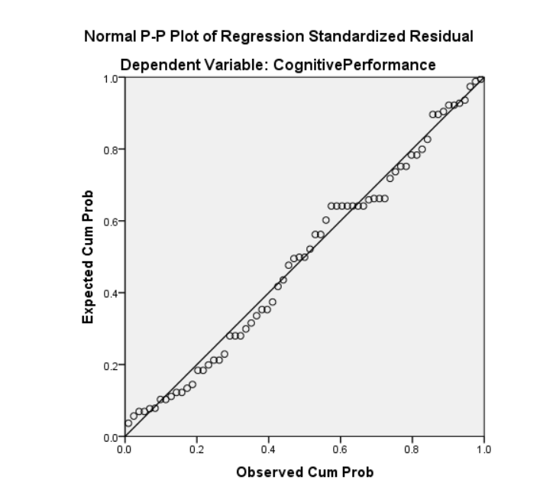
.
Independent variable 1: Sleep Duration
.
Normal Probability plot:

Slide 8
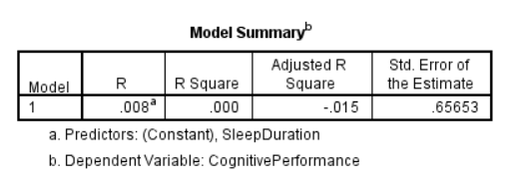
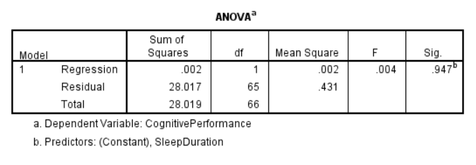
.
.
Summary table:
Anova table

Slide 9
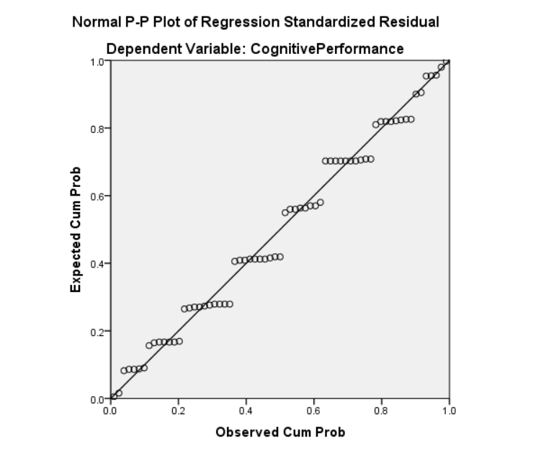
.
Independent variable 2: Sleep Quality
.
Normal Probability plot:

Slide 10
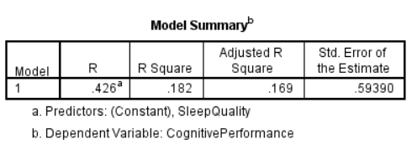
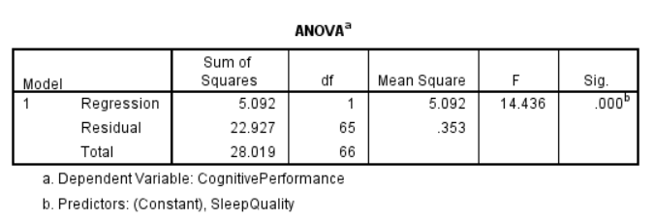
.
.
Summary table:
Anova table

Slide 11
.
Independent variable 3: Sleep Architecture
.
Normal Probability plot:

Slide 12
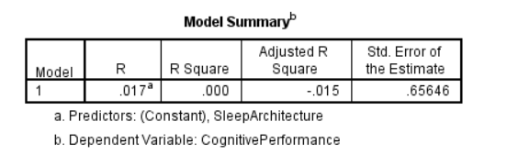
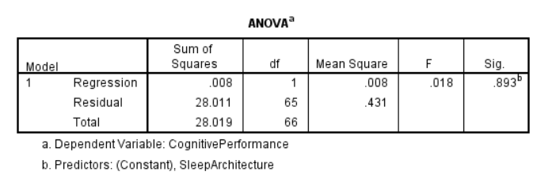
.
.
Summary table:
Anova table

Slide 13
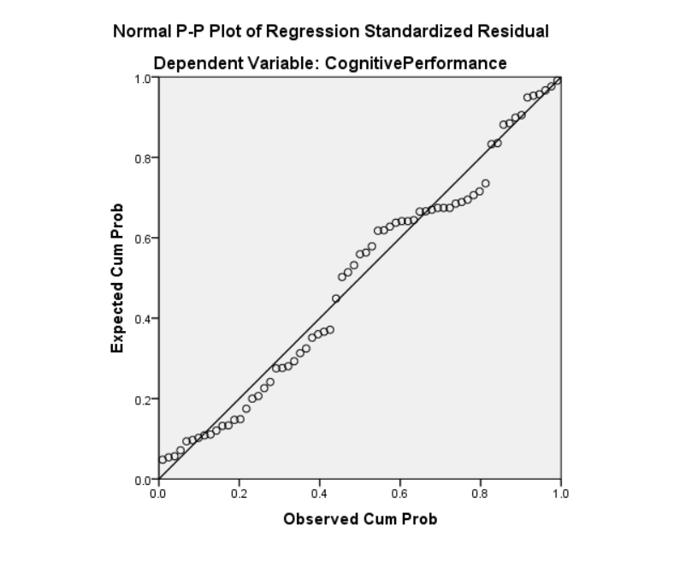
.
MULTIPLE VARIABLE REGRESSION ANALYSIS
.
Normal Probability plot:

Slide 14
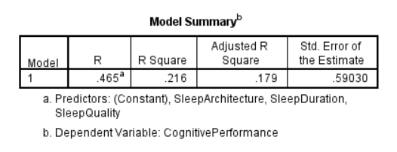
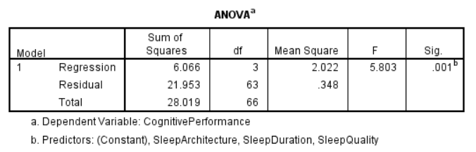
.
.
Summary table:
Anova table

Slide 15




Thank you

